Slide 1

REGEX-BASED INFORMATION EXTRACTOR FOR EMAILS AND DOCUMENTS
Presented by : C.Manoj kumar(192472008)
K.Sadiq hussain(192425108)
Guide name : (Saravanan M.S)

Slide 2


INTRODUCTION:
Emails and documents contain valuable information, but finding it manually is slow and may miss details.
Regex uses patterns to automatically extract emails, phone numbers, dates, URLs, PAN and Aadhaar-like numbers.
Extracted information is validated and evaluated for accuracy and performance.
APPLICATIONS:
Banking, KYC and HR: Extracts and checks PAN, Aadhaar-like numbers, and dates, which reduces entry errors.
Data security: Detects sensitive details in documents so they can be masked.

Slide 3


ABSTRACT
Emails and documents contain important details such as email IDs, phone numbers, dates, and URLs hidden in unstructured text.
Extracting this information manually is slow, error-prone, and difficult to scale.
This project develops a regex-based information extractor that automatically finds required data using pattern matching.
Extracted values are validated to remove invalid and false matches.
The extractor is evaluated using precision, recall, F1-score, and execution time.
The system is lightweight, fast, and needs no training data.

Slide 4
PROBLEM STATEMENT & OBJECTIVES
Problem Statement
How can important details like emails, phone numbers, and dates be extracted accurately from large amounts of unstructured text without slow manual effort?
How can we ensure the extracted information is valid and the extraction accuracy is actually measured?
Objectives
To design regex patterns that automatically extract information from emails and documents and validate it to remove false matches.
To evaluate extraction performance using precision, recall, F1-score, and execution time.

Slide 5
Existing System and Proposed System
Existing System
Proposed System
A
Existing regex scripts extract emails and dates from text, but they do not validate the matches and focus mainly on speed.
NER and LLM-based methods need training data or heavy resources, and the accuracy of results is rarely measured.
Automatically extracts emails, phone numbers, dates, URLs, and IDs using Regex and validates them to remove false matches.
Evaluates performance using Precision, Recall, F1-Score, and execution time, with no training data needed.

Slide 6
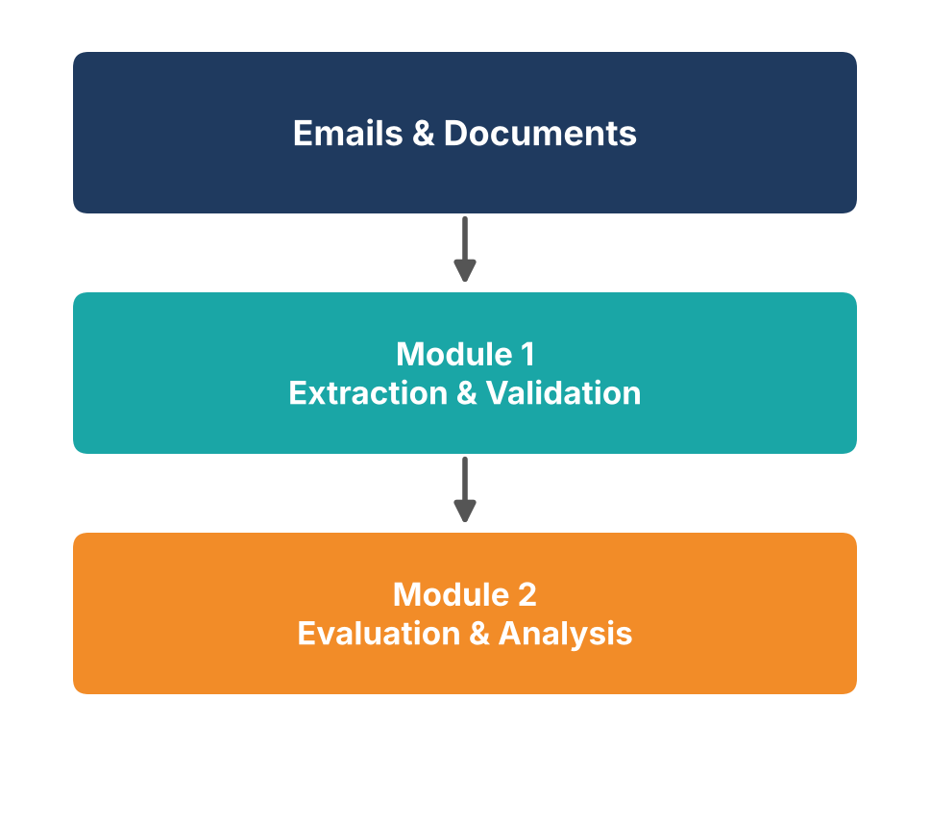
MODULES
Module 1 – Information Extraction and Validation
Outcome: accurately extracted and validated emails, phone numbers, dates, URLs, and IDs, with false matches removed.
Module 2 – Performance Evaluation and Result Analysis
Outcome: measured Precision, Recall, F1-Score, and execution time that show how accurate and fast the system is.

